Slide 1
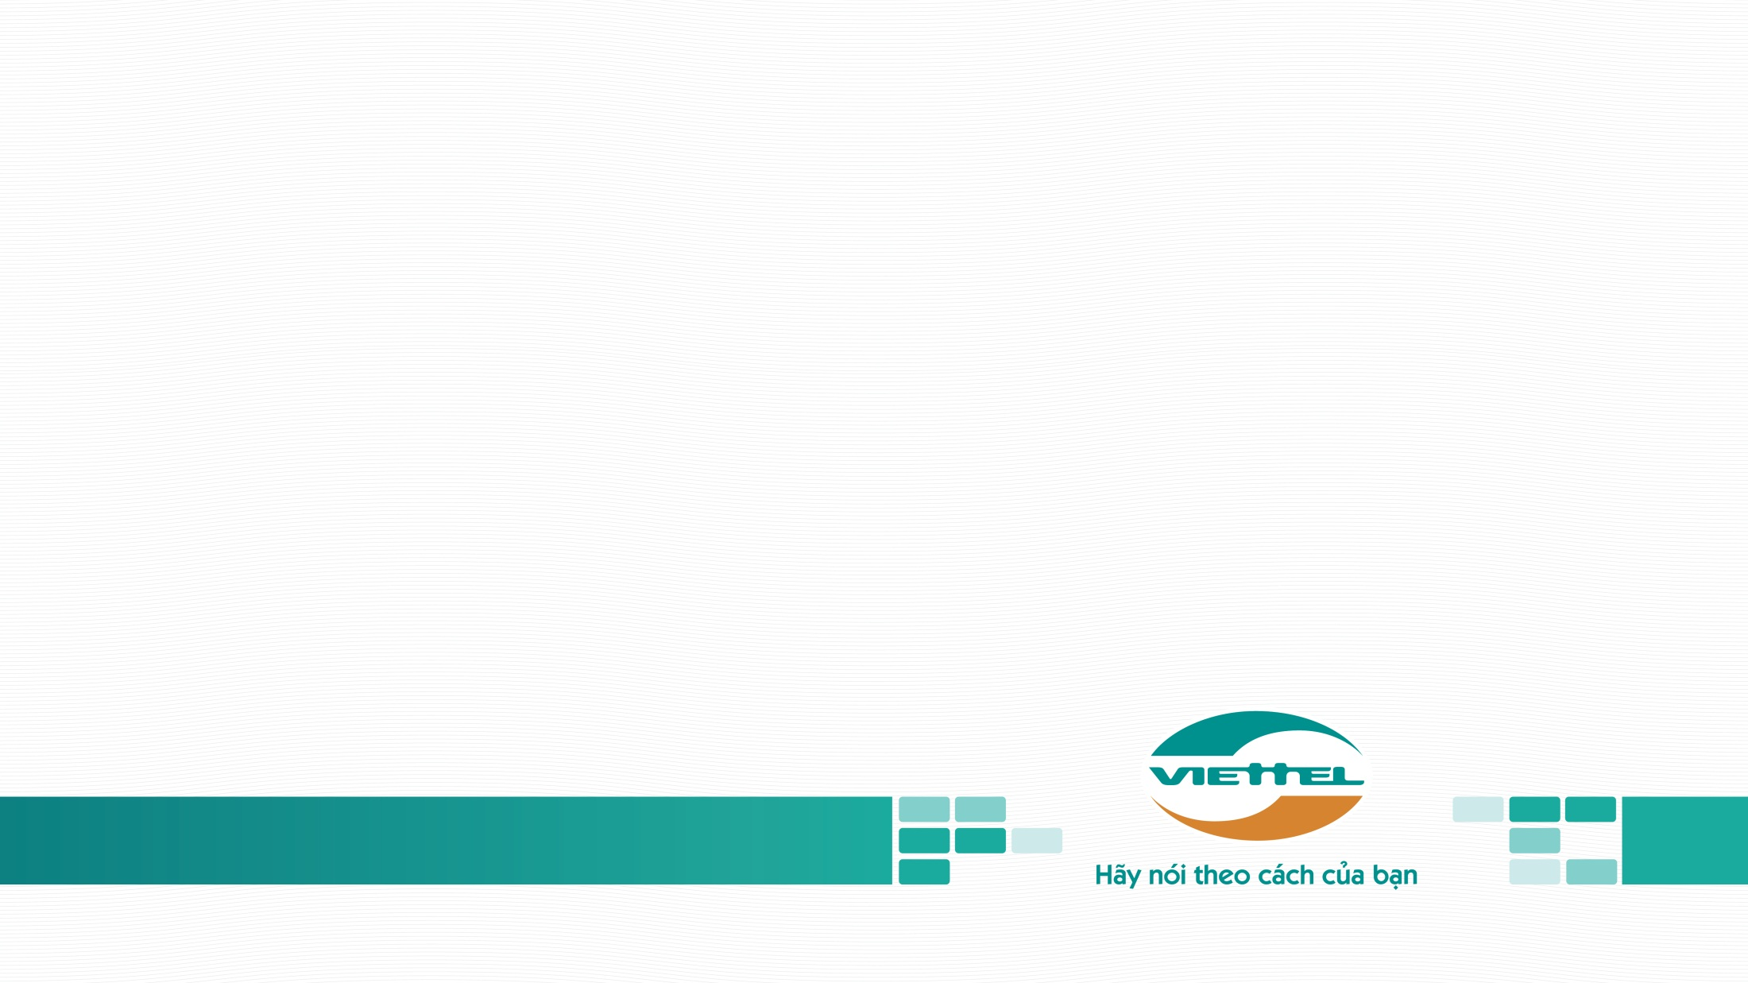
Unit testing
TỔNG CÔNG TY CÔNG NGHIỆP – CÔNG NGHỆ CAO VIETTEL
Kiều Tấn Phát

Slide 2
CONTENT
TYPES OF TESTING
I
TEST-DRIVEN DEVELOPMENT
II

Slide 3
TYPES OF TESTING

Slide 4
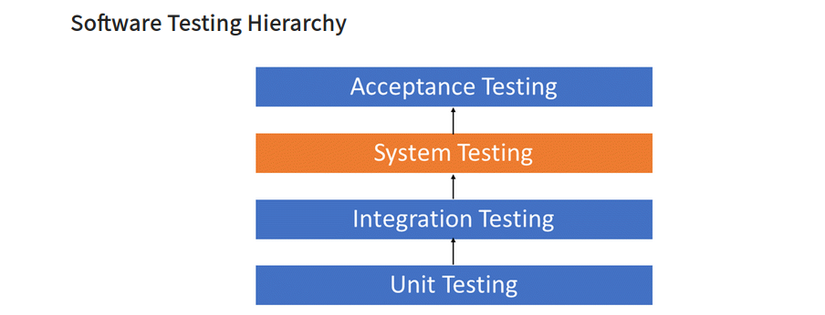

Slide 5
SYSTEM TEST
Definition: System testing is defined as testing of a complete and fully integrated software product. This testing falls in black-box testing wherein knowledge of the inner design of the code is not a prerequisite and is done by the testing team.
Description: System testing is performed in the context of a System Requirement Specification (SRS) and/or a Functional Requirement Specifications (FRS). It is the final test to verify that the product to be delivered meets the specifications mentioned in the requirement document.

Slide 6
INTEGRATION TEST
Integration Testing is defined as a type of testing where software modules are integrated logically and tested as a group. A typical software project consists of multiple software modules, coded by different programmers. The purpose of this level of testing is to expose defects in the interaction between these software modules when they are integrated

Slide 7
UNIT TEST
Low level and close to source of application
Consist in testing individual methods and functions of the classes, components, or modules used by your software.
A method that validates a small portion of the source code

Slide 8
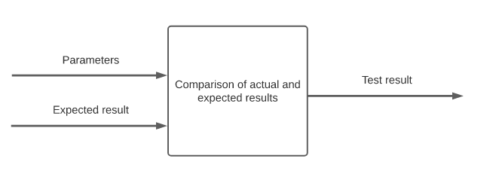
UNIT TEST
The unit test takes the initial data, passes it to the code under test, and asserts if the execution result is the same as the expected result:

Slide 9
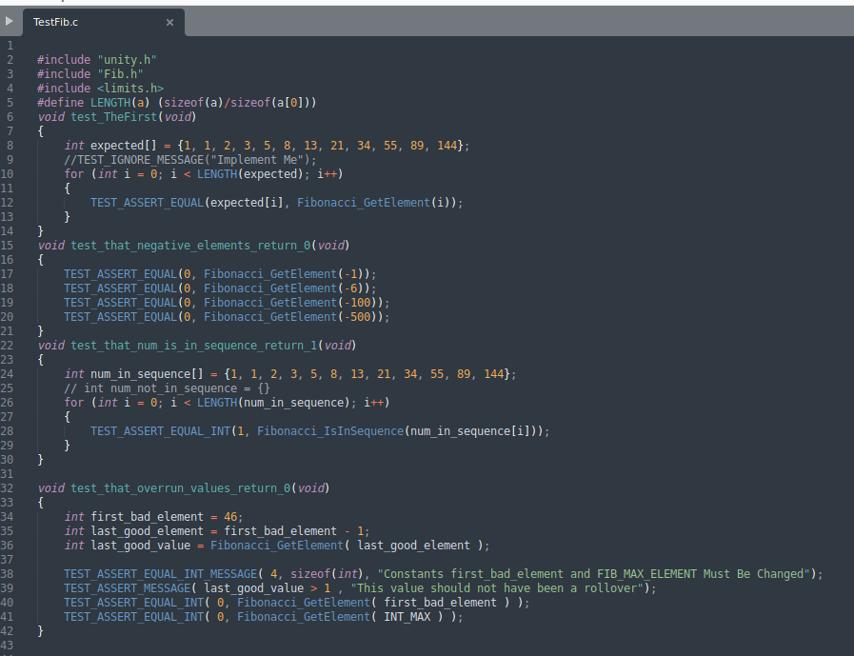
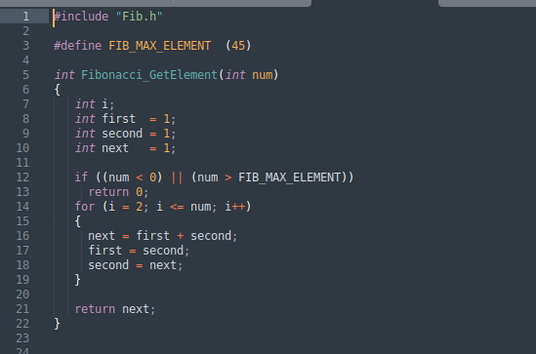
Example

Slide 10
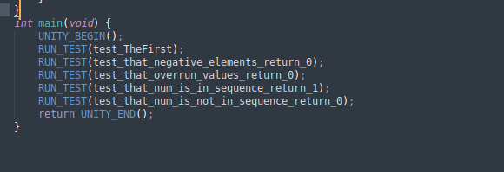
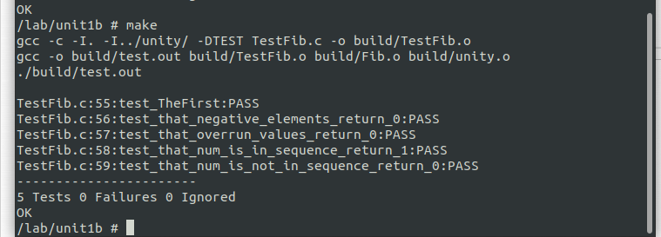

Slide 11
UNIT TEST
Efficient unit tests could be complicated depending on the code we want to test. A well-written unit test should be:
Fast
Isolated
Deterministic
Readable
Simple
Notes:
Fast. A single project can contain a big number of unit tests, even hundreds, or thousands. Moreover, unit tests can be executed often, e. g., while developing a new feature to avoid regression or in CI/CD pipelines. Therefore, they must run as fast as possible.
Isolated. A unit test shouldn’t modify or depend on any external state.
Deterministic. A unit test should always return the same result no matter how many times we execute it. Of course, if nothing is changed between runs.
Readable. Unit tests are code that needs to be maintained. Therefore, it should be clear and easily understandable.
Simple. Often we can read that the unit test should contain a single assertion. Although it can be discussable, the fact is unit tests should validate small portions of the source code.

Slide 12
UNIT TEST
Benefits of unit test
Ensure that the code works as intended
Avoid time-consuming
Improve Code quality(loose coupling, high cohesion, consistent design and maintainable)
Reduce the total cost and time of software development
Notes:
We already know how to write unit tests. Let’s describe the benefits they bring. First of all, it ensures that the code works as intended. We can write unit tests for different scenarios, edge cases, and parameters.
Secondly, we can run those scenarios whenever we need them, e.g., while working on the code. It saves time, as going through all of those scenarios manually would be surely time-consuming. Moreover, fast and easy testing while working on the code helps avoid regression in existing features.
Next, writing unit tests improves code quality. That’s because testable source code needs to be well written. Therefore classes and methods are automatically smaller and more specific.
An important benefit of unit tests is that they reduce the total cost and time of software development. Early bugs detection results in easier and faster fixing than if done later as the project grows.

Slide 13
TEST-DRIVEN DEVELOPMENT
TDD is an approach to software development in which the unit tests are written before the business logic. In other words, developers write unit tests for the feature before implementing it.

Slide 14
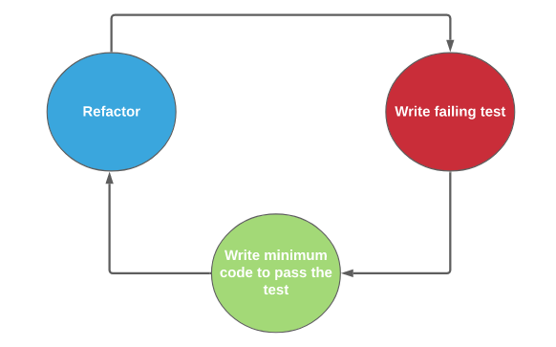
TEST-DRIVEN DEVELOPMENT
A TDD cycle consists of three stages:
Red – during this stage we write a test for functionality that is not yet implemented.
Green – during this stage we write enough code to just cover the test.
Refactor – final stage, here we focus on improving the code quality.
Notes:
Red – during this stage we write a test for functionality that is not yet implemented. We need to run the test to ensure it’s failing. Otherwise, we’ll get a false positive which means the test is badly written. Most popular IDE’s displays test failures using red color. That is why the stage is called red.
Green – during this stage we write enough code to just cover the test. We should focus on covering the test, not on the code quality. We write a minimum amount of code to pass the test. IDE’s often signals passing tests with a green color. So, the stage is called green.
Refactor – final stage, here we focus on improving the code quality. Therefore, we should make all refactors needed to improve the code. While making changes, we can run the tests to avoid any regression.

Slide 15
TEST-DRIVEN DEVELOPMENT
The code of unit test need to meet all requirements and clients’ needs. It’s one of the most important aims of TDD.
The cycles play an important role, as the tests become more specific with time while the implementation becomes more generic.

Slide 16
COMPARISION
TDD is a broader concept than unit tests. TDD is a software development approach focused on understanding the problem domain and fulfilling the requirements. Bare unit tests are about validating the written source code and avoiding bugs and regression. In fact, unit tests are part of the TDD cycle.
Secondly, while using TDD unit tests must be written before the feature that they cover. While bare unit tests can be written at any time, e.g., during or after the feature development.
Last but not least, TDD requires the cooperation of all parties involved in the project. Whereas bare unit tests are mainly the developer’s responsibility.

